Slide 1
Learning to Recall Dreams from Dreamers
A sleep-EEG study
Arna Ghosh

Slide 2
Major Takeaways from Brainhack School
Knowledge about basic MRI and fMRI concepts and processing pipelines
Preprocessing & Visualization tools - nilearn, mne
Keras for quick deep learning implementation
Graph Convolutional Networks
Some great discussions on potential project ideas for upcoming BrainHacks

Slide 3
Major Goals
Train a deep convolutional architecture to discriminate people with high dream recall rate (dreamers) from those with low dream recall rate (non-dreamers)
Observe the decoding (classification) accuracies for different sleep stages to identify key sleep stage containing differences
Try to train on identifying individual subjects - use as person identification tool

Slide 4
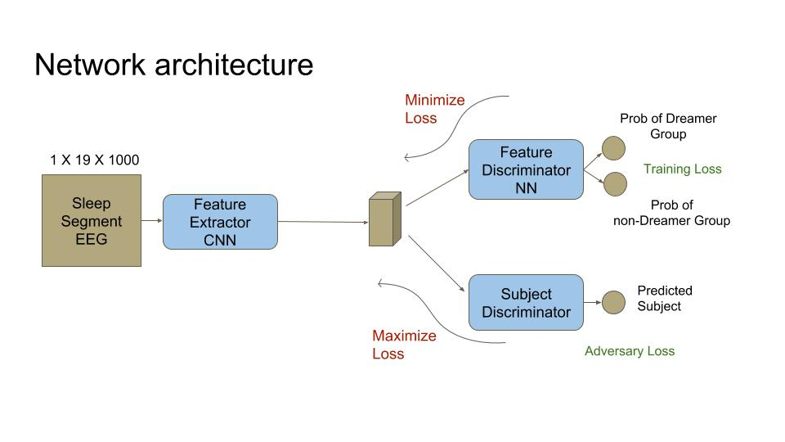

Slide 5
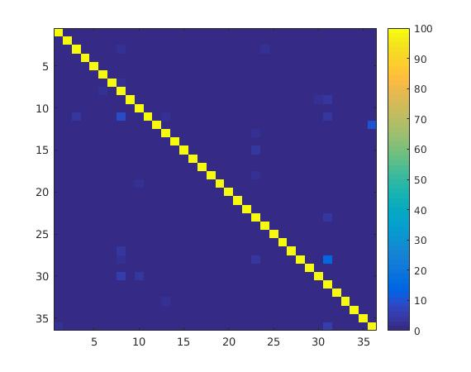

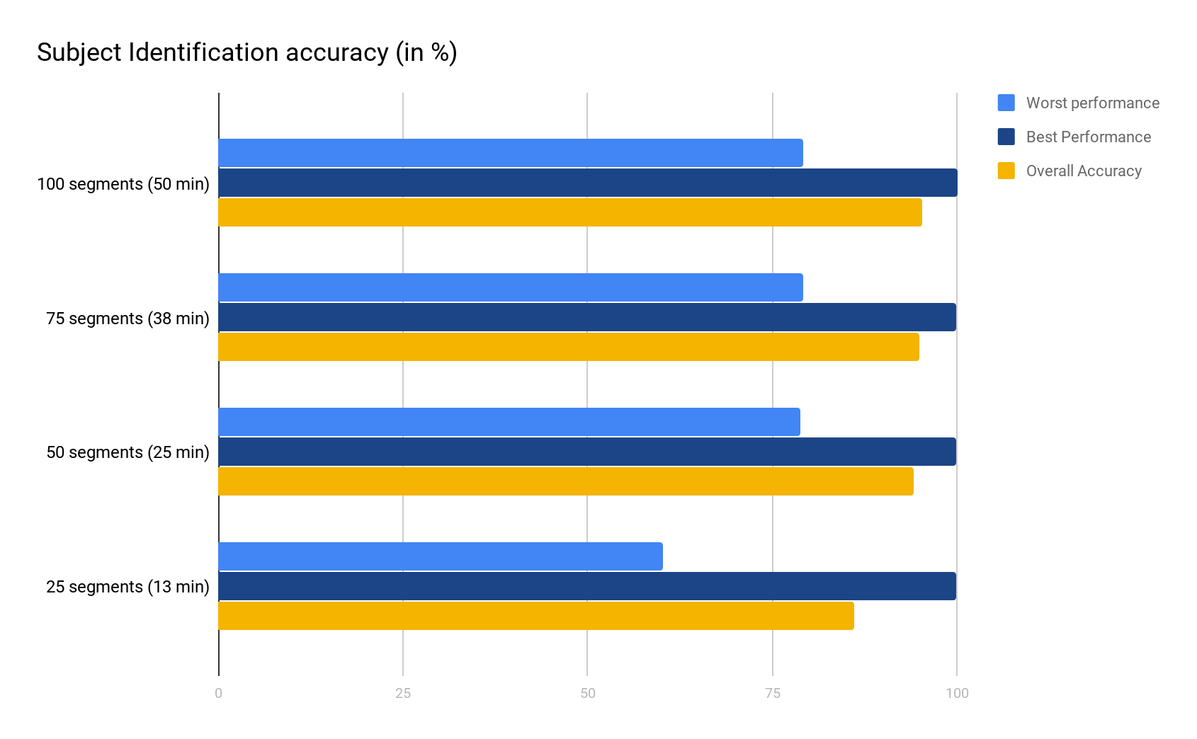
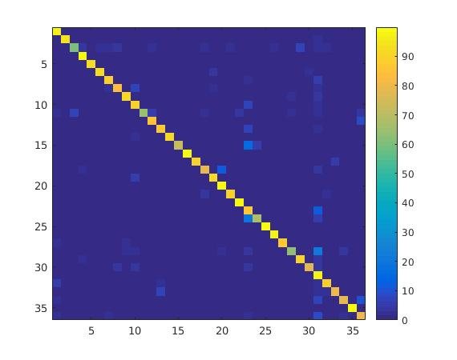
Project Updates and Results
Only SWS stage data used
Subject prediction with less data → need to check with baseline methods using ML techniques
More linear layers were required to learn subject-specific features → subject adversary to have more linear layers that group classifier
100 segments
50 segments
25 segments

